Slide 1
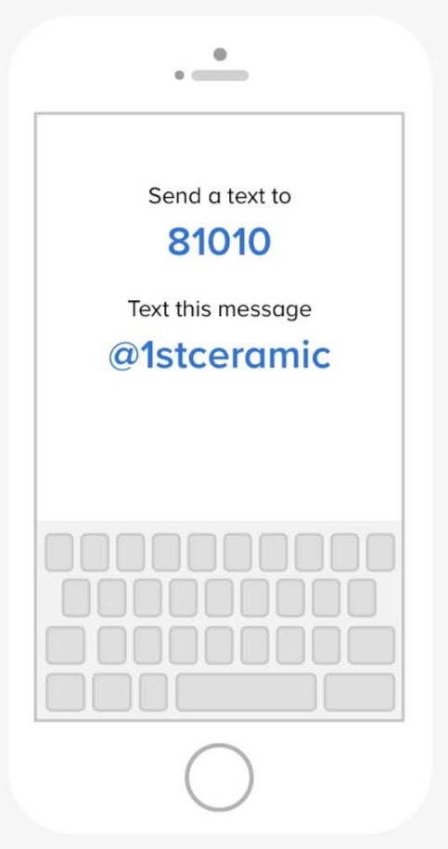
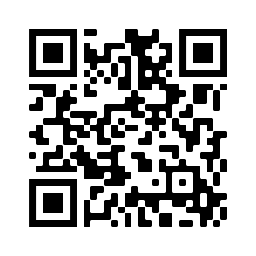
Welcome to Ceramics/Sculpture
Please do the following, for a GRADE:
(if you didn’t already do it yesterday!)
1. Complete info: 2. Join Remind:

Slide 2
Teacher Contact:
Email: Danielle.Walker@cobbk12.org
Blog: www.artwithwalker.weebly.com
Insta: @art_mceachern

Slide 3
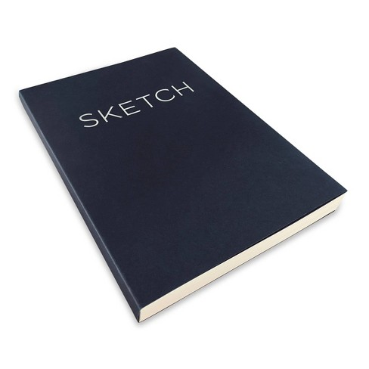
Required Materials:
Sketchbook
8 x 10 or larger

Slide 4
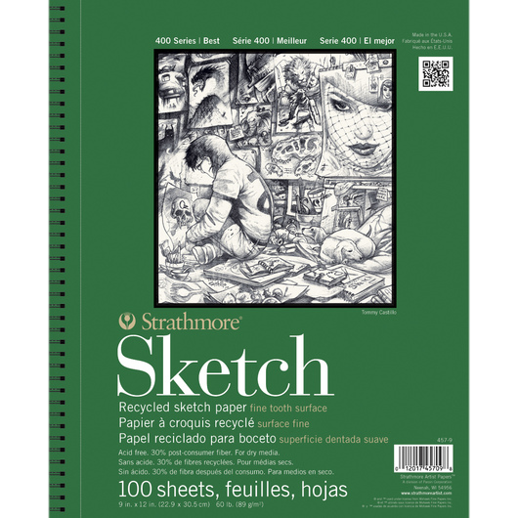
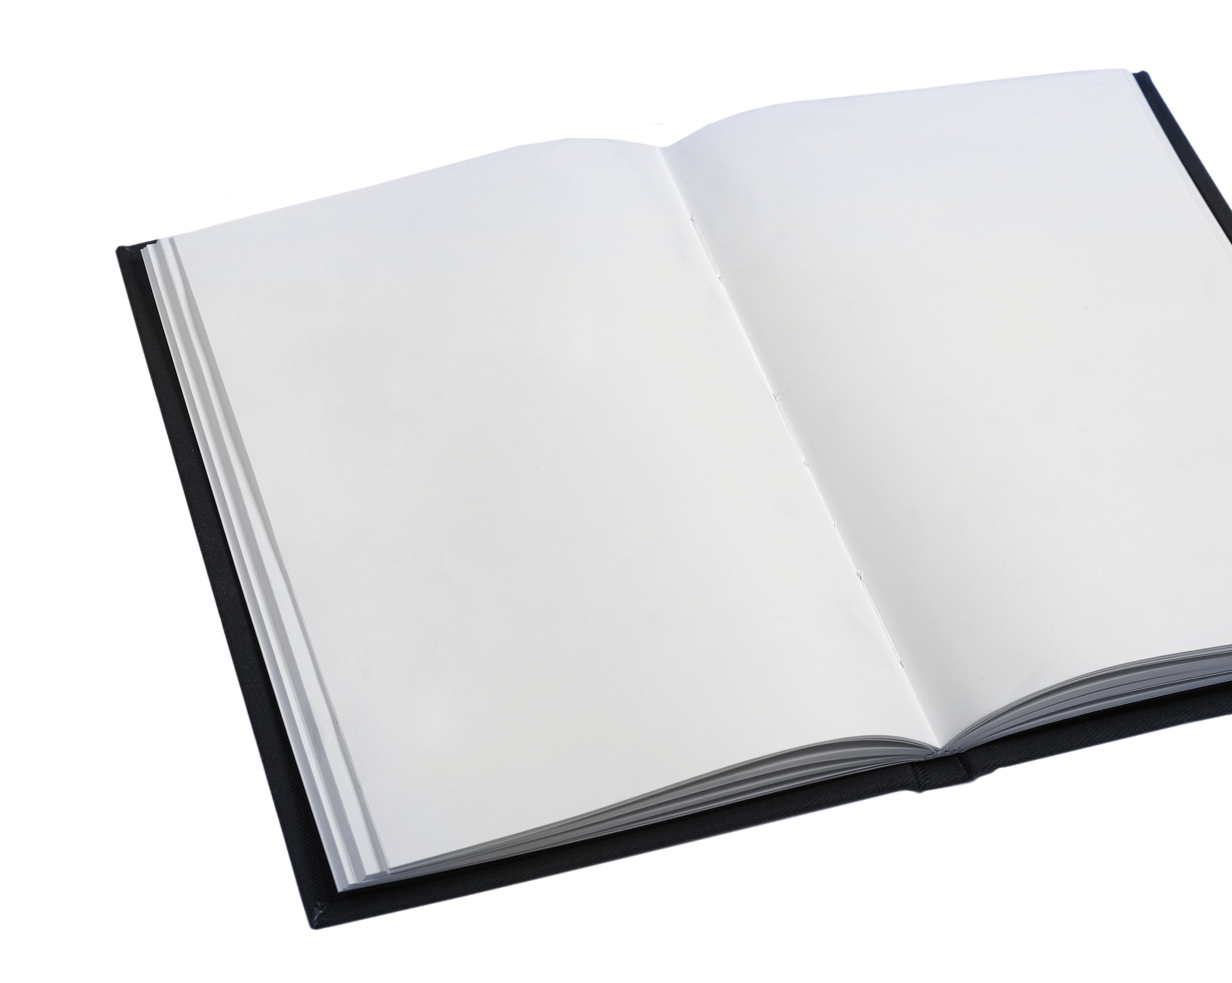
How to Choose a Good Sketchbook:
Clear Pages (no lines)
Page Count

Slide 5
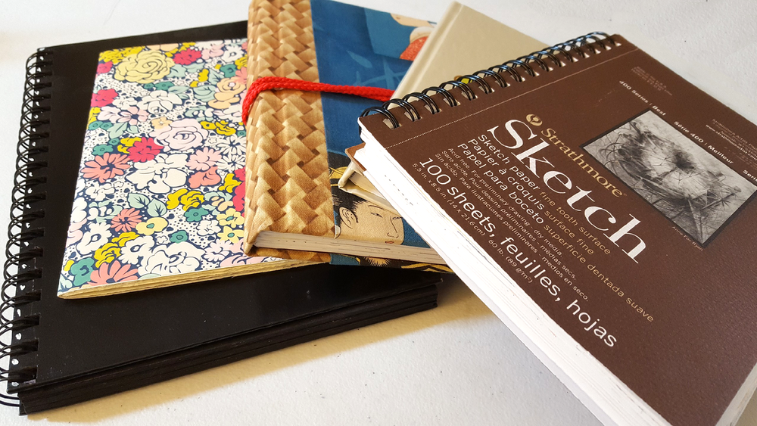
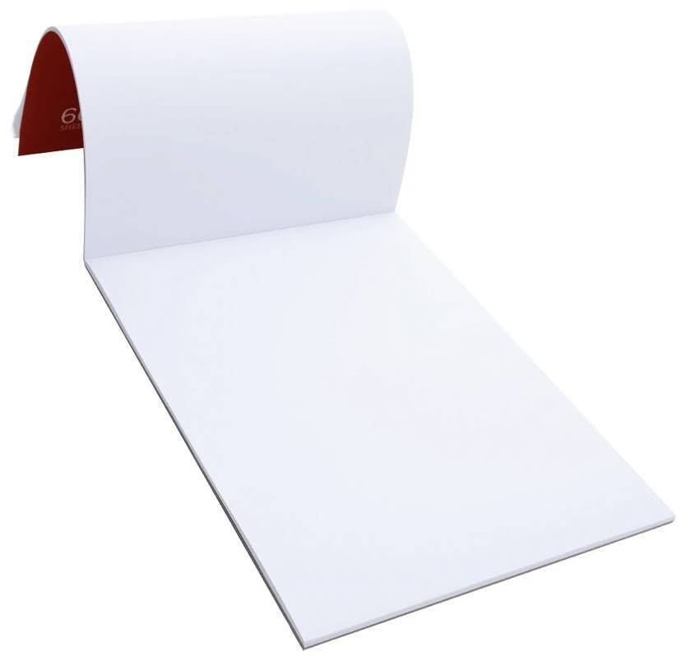
3. Cover/Binding Quality
Hard Cover / Cardboard will last longer
Spiral Binding Allows to open and lay flat
DO NOT get the tear away kind!

Slide 6
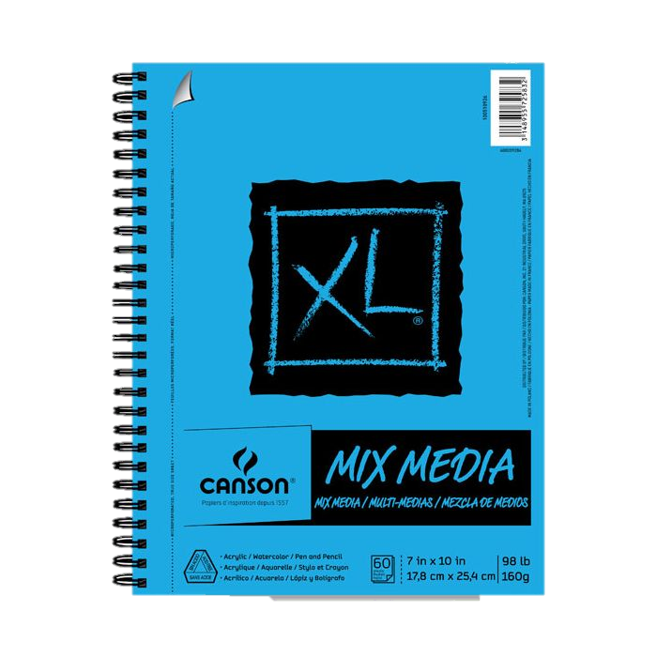
4. Paper Quality
70lb or heavier holds up to paint
Sketchbooks that say “mixed media” or
“paint” will be heavier

Slide 9
